Slide 1
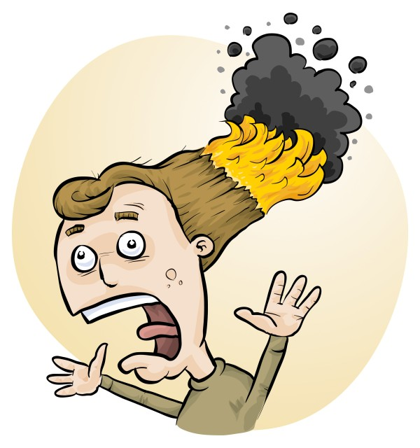
Dangerous chemicals! How can I use them safely?
Phillip and Eva Crisp

Slide 2
Safety Data Sheets
For every chemical or chemical product:
• SDS must be available (usually on web)
• SDS must include * classification according to GHS * GHS label elements: signal word, pictograms, hazard statements
BUT
• no system for checking accuracy of SDSs
• no system for checking data are up-to-date
• no penalties
Often major differences between SDSs
for the same chemical!
2

Slide 3
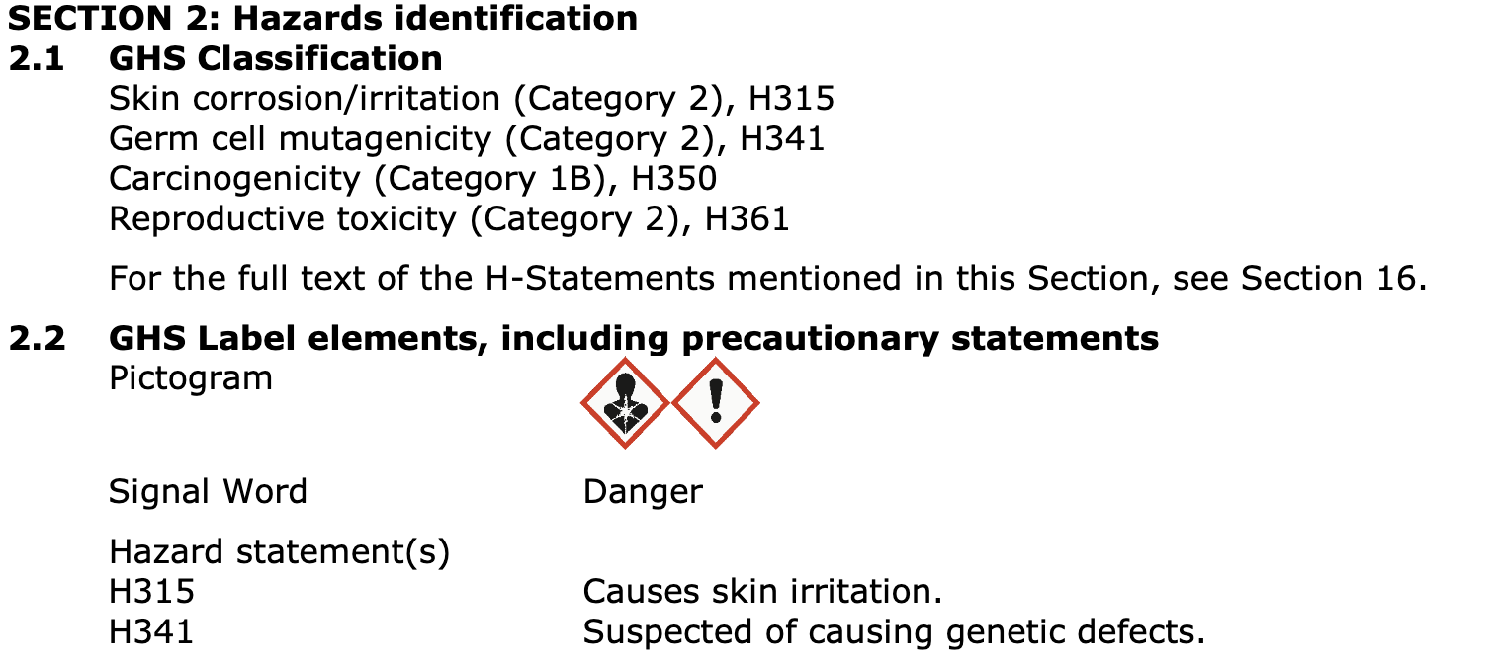
Phenolphthalein (Merk)
3

Slide 4
1. How do we obtain the most accurate GHS data? 2. What do we do with common chemicals with hazardous properties?
Questions
4

Slide 5
Most accurate GHS data
Reliance on a SDS from a single manufacturer/supplier is unwise
(though legally required to have the manufacturer’s SDS available!)
Fortunately, there is a vast database of classifications according to GHS available from the
European Chemicals Association (ECHA)
5

Slide 6
ECHA
Compiles classifications of chemicals according to GHS from throughout Europe and Scandinavia
Most extensive resource of which we are aware
https://www.echa.europa.eu/information-on-chemicals/cl-inventory-database
6

Slide 7
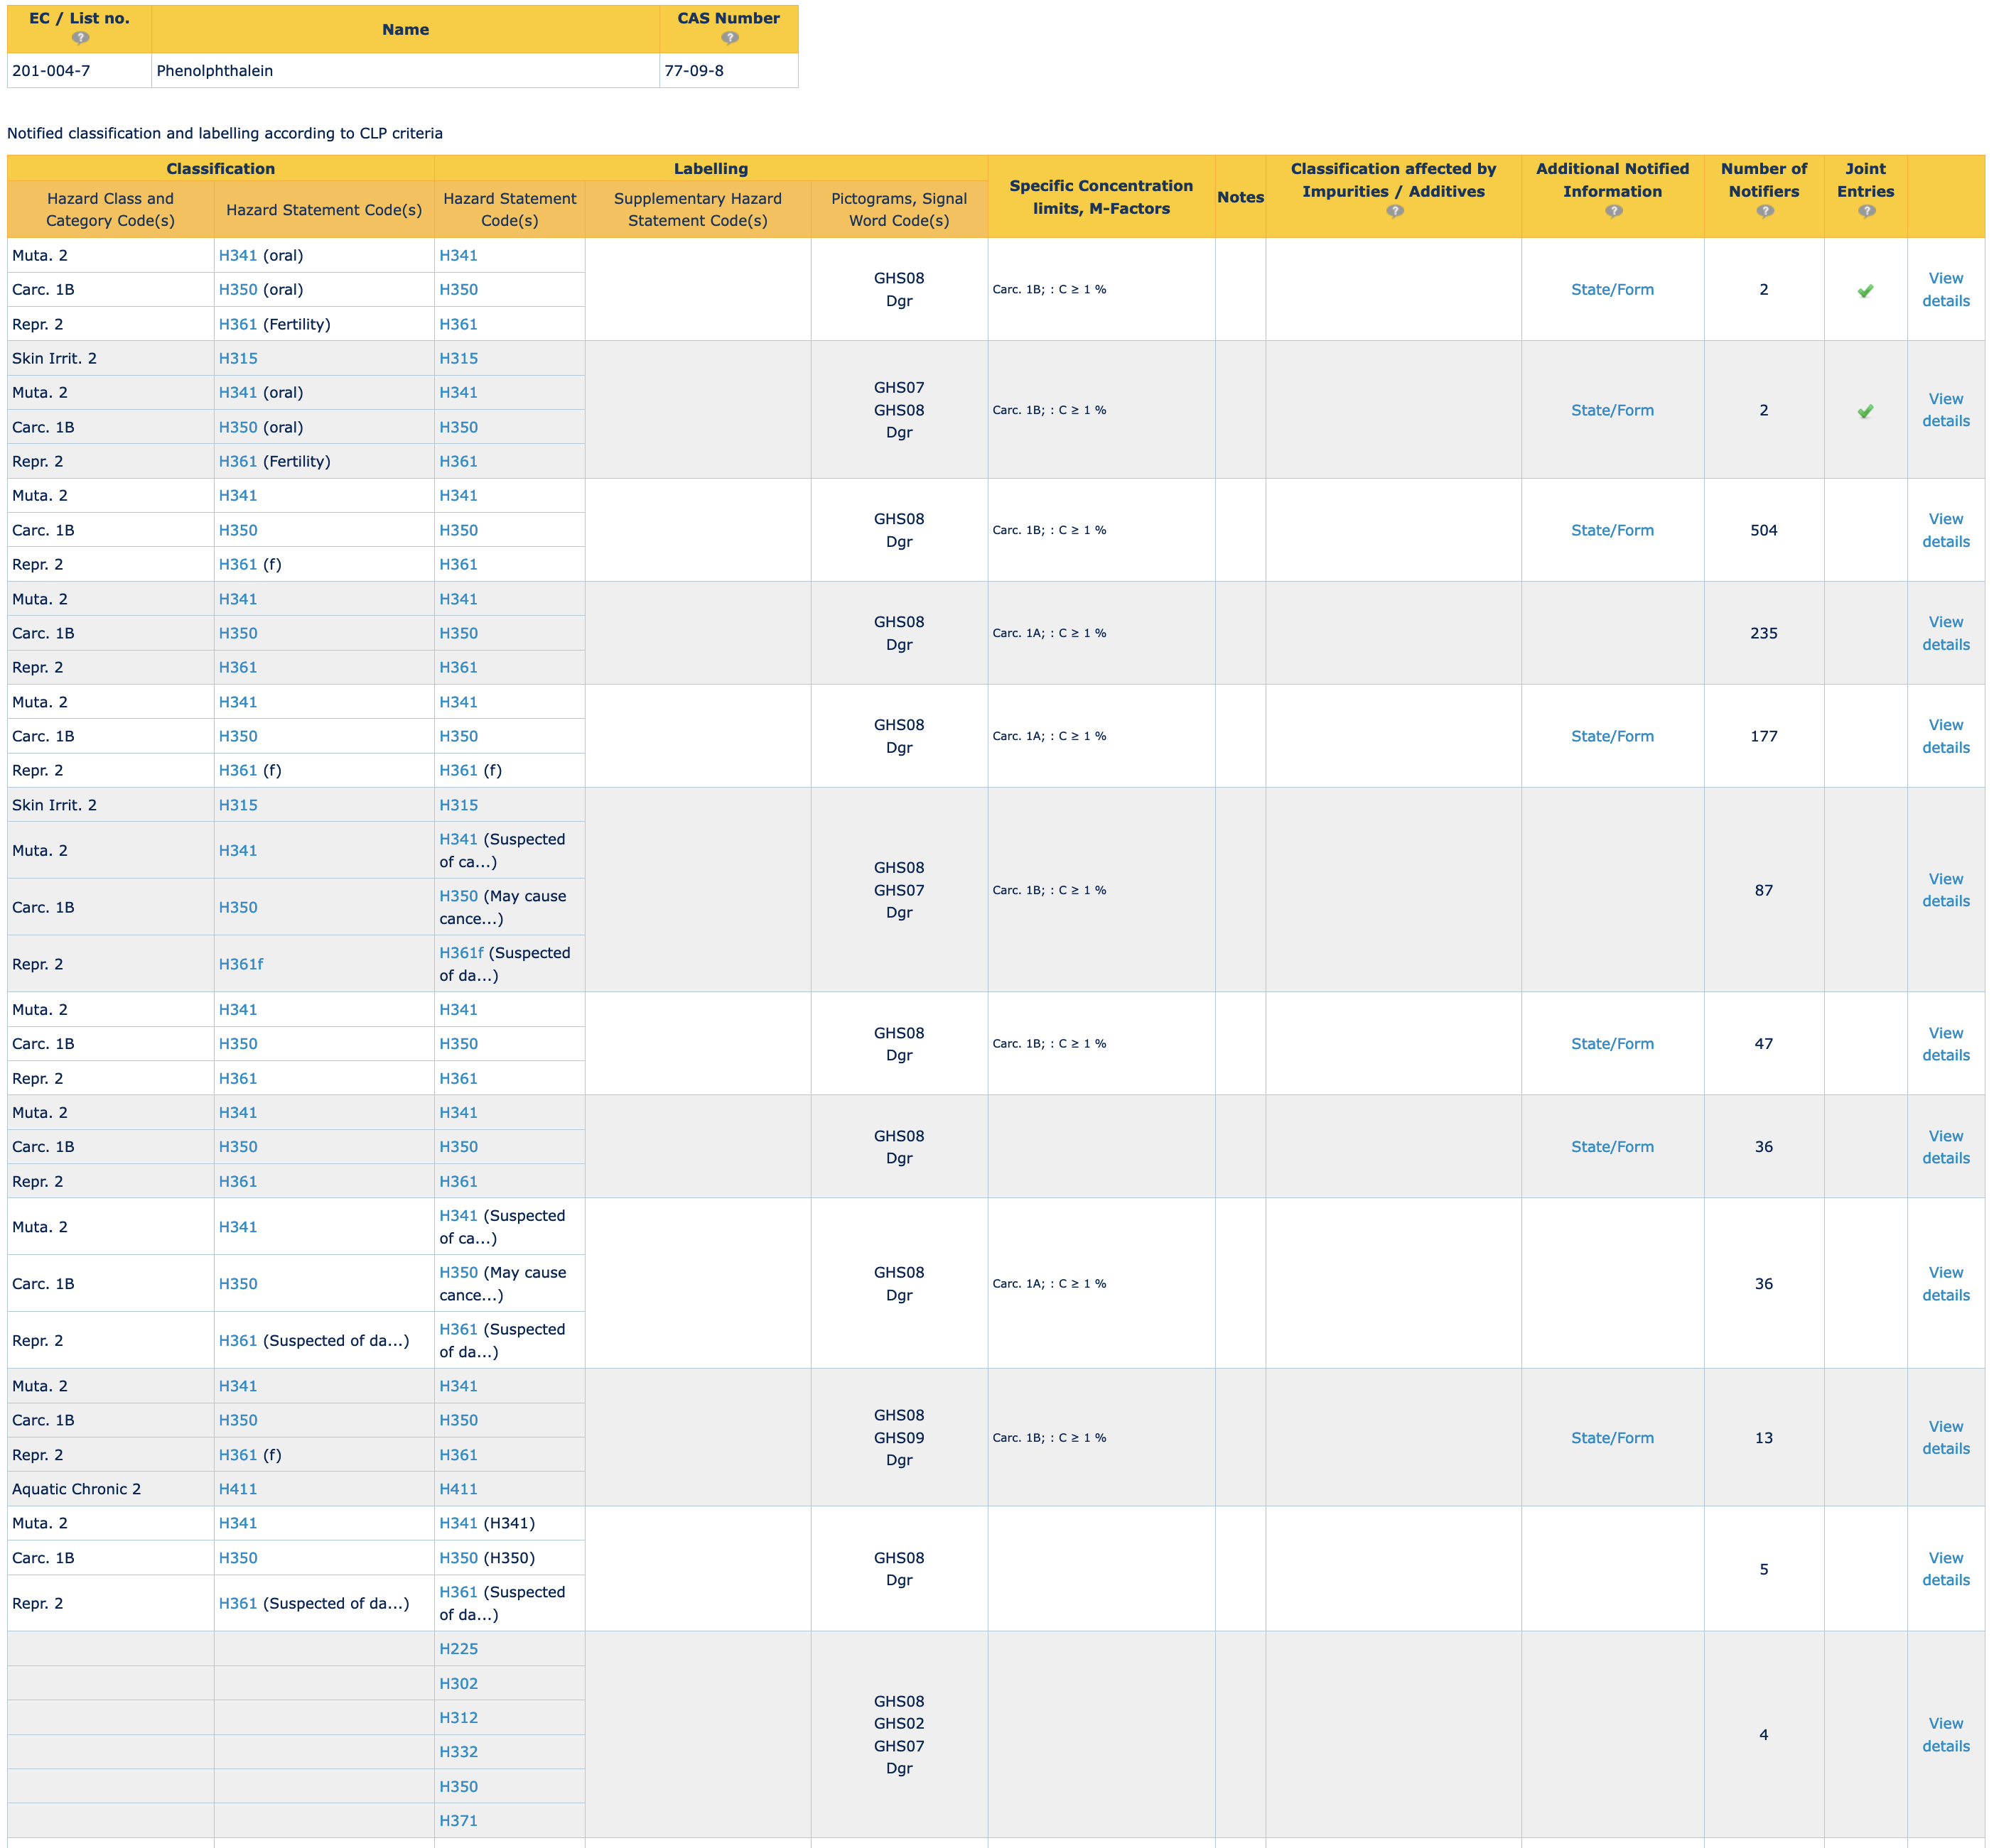
7

Slide 8
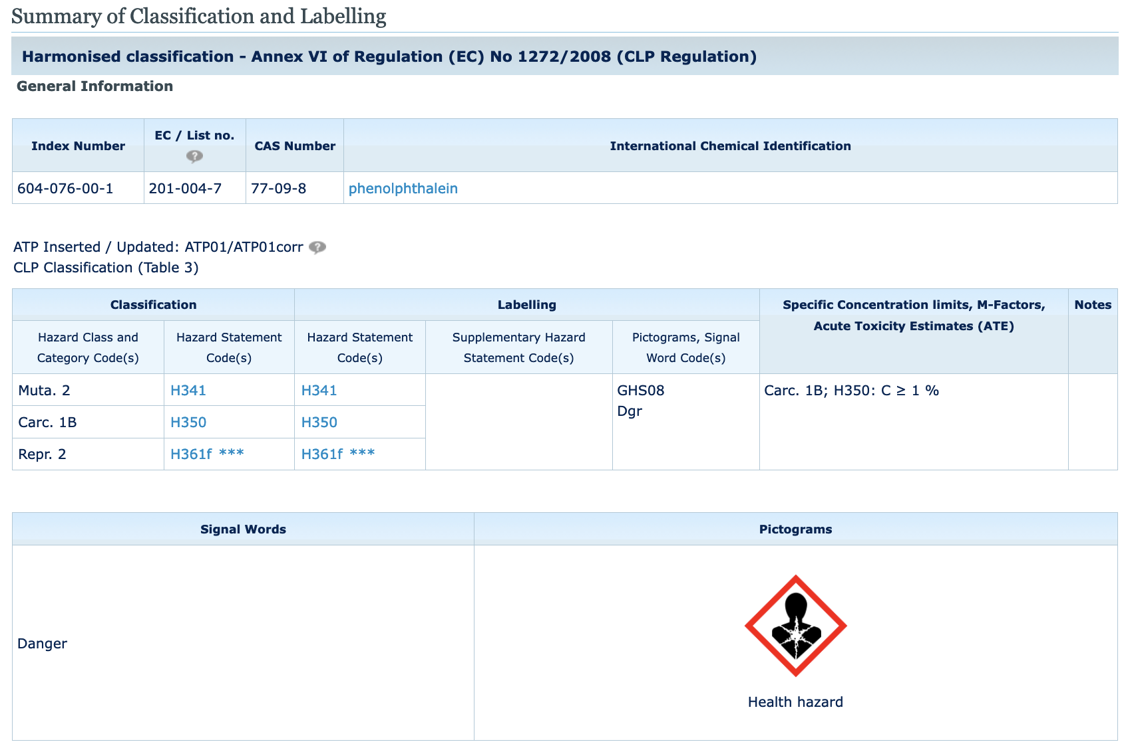
8

Slide 9
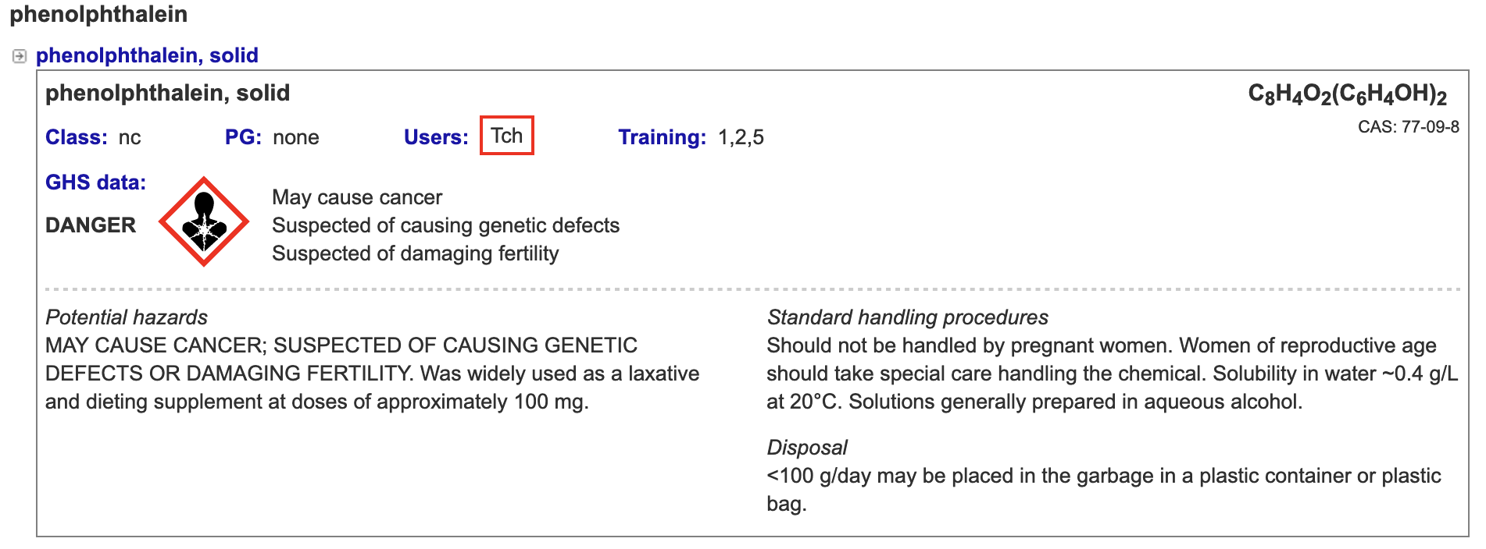
9

Slide 10
Aqueous solutions
Common industrial chemicals
use specific concentration limits for hazards,
if given in harmonized classification
Uncommon chemicals
Use rules for mixtures in the latest version of the GHS, separately for each hazard,
treating the solution as a mixture of chemical and water, with water as an inert diluent
https://www.riskassess.com.au/docs/GHSdataSolutions.pdf
10

Slide 11
Common chemicals with hazardous properties
• phenolphthalein
• sodium tetraborate (borax)
• lead salts
• copper(II) sulfate
• glyphosate
11

Slide 12
Phenolphthalein
May cause cancer, suspected of causing birth defects and damaging fertility
Used as a laxative and weight-loss drug for many decades, typically at doses of 100 mg/day
Student use of a few drops of dilute solution for a titration is very different to ingesting 100 mg/day
Females should take great care with the solid
Pregnant females should avoid handling the solid
12

Slide 13
‘Boys and girls come out to play, happy and gay the Laxette way!’
13

Slide 14
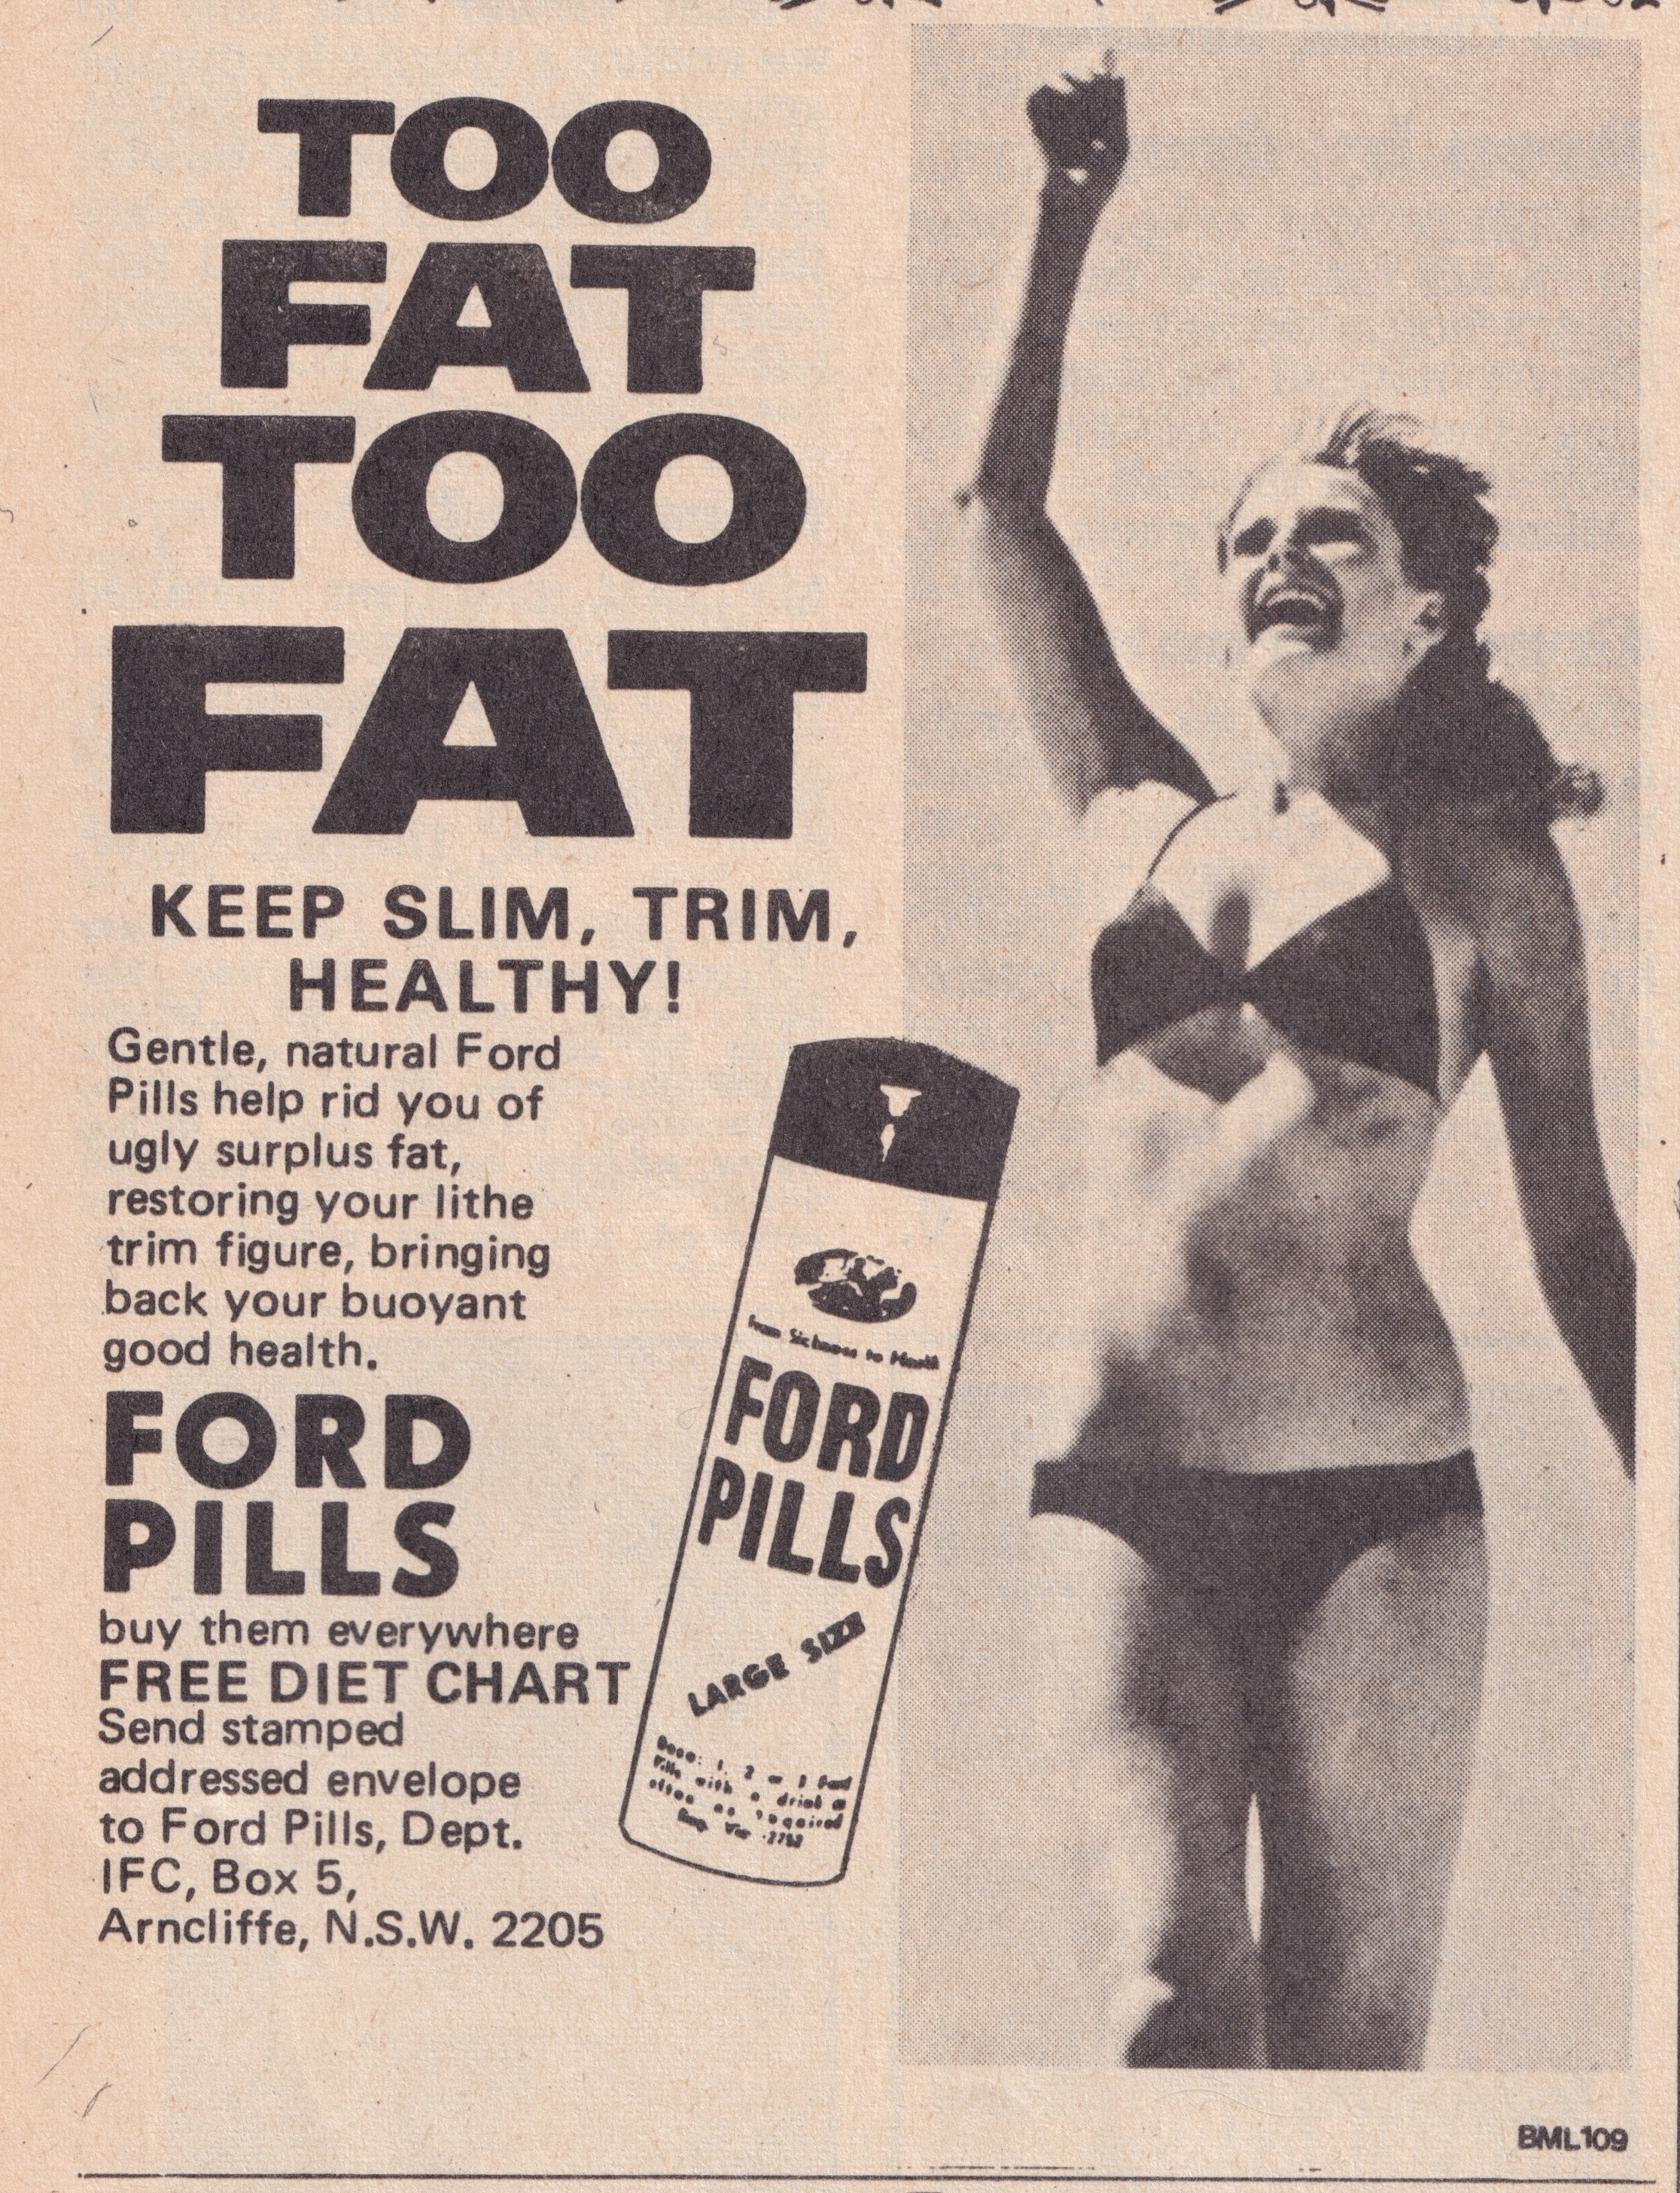
‘Ford pills can help make you as attractive as the girls your husband stares at in the street’
Australian Womens Weekly, 29 March 1972
14

Slide 15
Borax
May damage fertility or the unborn child
Used in small amounts in ‘slime’ Not volatile, not absorbed through unbroken skin
Previously ‘Not classified as hazardous according to GHS’ at concentrations below 4.5% wt/wt, according to ECHA. Now classified as hazardous to 0.1% wt/wt.
Use smallest possible amount of borax in slime. Ensure that students do not eat it and wash hands carefully after playing with it (especially K-3).
Or use slime formulation without borax.
15

Slide 16
Lead salts
May damage the unborn child and suspected of damaging fertility
May cause damage to organs through prolonged or repeated exposure
Very toxic to aquatic life with long lasting effects
Not volatile or absorbed through unbroken skin
Student use of a few drops of dilute solution for spot tests should be safe, with control measures.
Explain toxicity, collect all residues.
Pregnant females should avoid handling the solid
16

Slide 17
Copper sulfate
Harmful if swallowed, causes serious eye damage, very toxic to aquatic life with long lasting effects
Commonly used, even in K-6.
Not volatile, not absorbed through unbroken skin.
Recent change: ‘eye irritation’ to ‘eye damage’.
Avoid solid or concentrated solution in eyes. Wear safety glasses. Minimal release to the environment.
17

Slide 18
Glyphosate (Roundup)
Suspected of causing cancer, causes serious eye damage
Widely used herbicide.
Not volatile, not absorbed through unbroken skin.
Agricultural workers were commonly drenched with the solution during crop dusting. Many instances of extreme exposure in agriculture.
Avoid inhaling aerosol when spraying.
Wear safety glasses.
18

Slide 19
Conclusion
Many chemicals with hazardous properties can be used safely, provided risks are assessed and control measures are put in place
Important to maintain the variety of chemicals
in order to maintain student interest and
increase their enjoyment of practical chemistry
19

